Slide 1

Project Future 10th cycle Project assignment
Melodica Business Intelligence Pipeline
Business intelligence & Data engineering

Slide 2



Powered by

Slide 3

MEET OUR TEAM
Christina Malliou
Alexandros Karapiperis
Evgenia Andreou
Nikolaos Toganidis
Konstantinos Charmantaris

Slide 4
INTRODUCTION
Melodica Media Corp., a multinational headquartered in California, has commissioned the development of a business intelligence pipeline to analyze track sales for its Melodica online music store. The pipeline involves defining objectives and key performance indicators, collecting and integrating data from diverse sources, implementing data cleaning and preprocessing procedures, establishing data models, and utilizing ETL processes for seamless data extraction and loading. Business intelligence tools, coupled with advanced analytics and potential predictive modeling, will be employed to create interactive dashboards and reports, providing valuable insights into track sales trends and customer behavior.

Slide 5
Technical Implementation

Slide 6
Tools
SSMS
SSIS
SSAS
Power BI

Slide 7
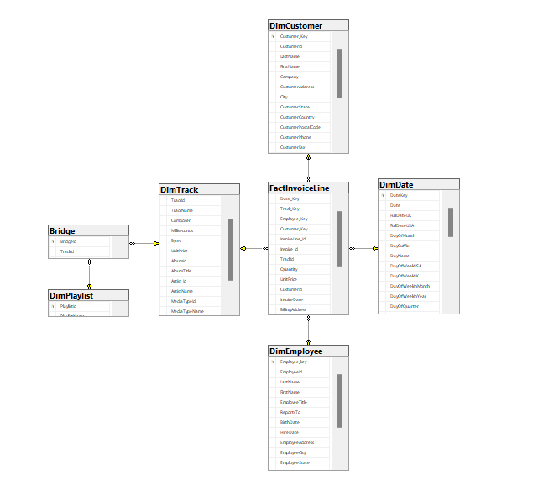
SSMS & DataWarehouse Snowflake Diagram

Slide 8
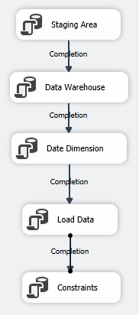

SQL Server Integration System
First Package is the full implementation of ETL via SQL tasks.
Second Package is about updating the data in DW.

Slide 9
Visualization & analysis

Slide 10
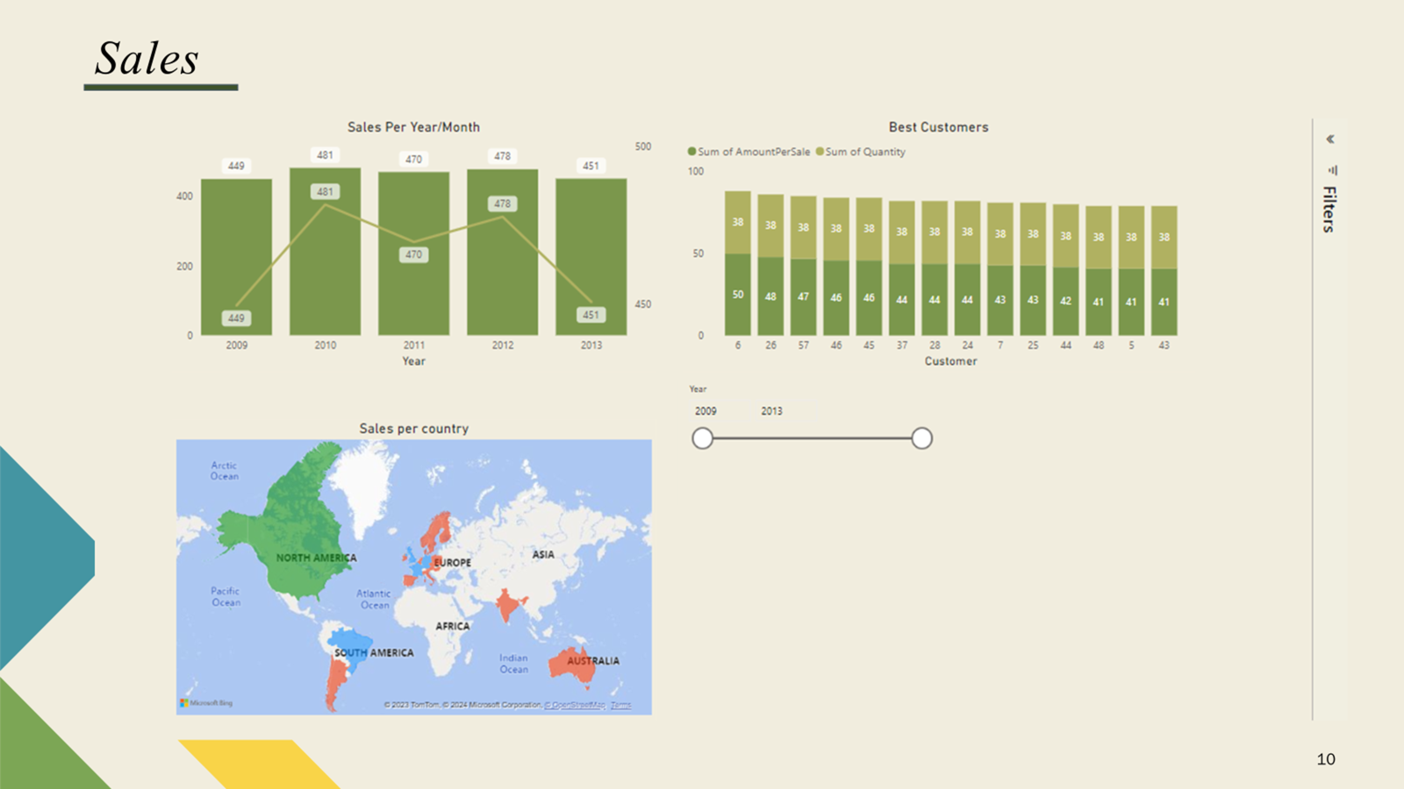

Slide 11
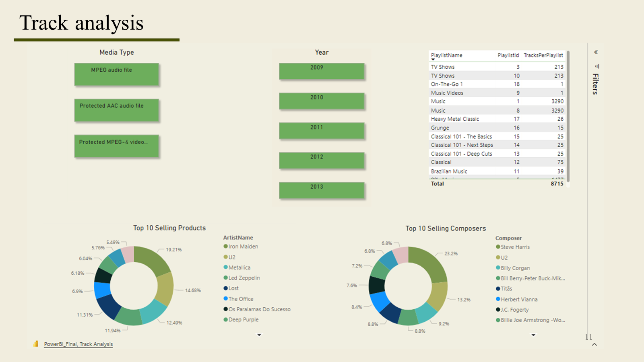

Slide 12
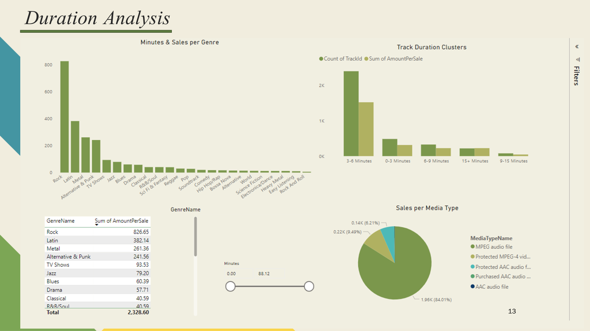

Slide 13
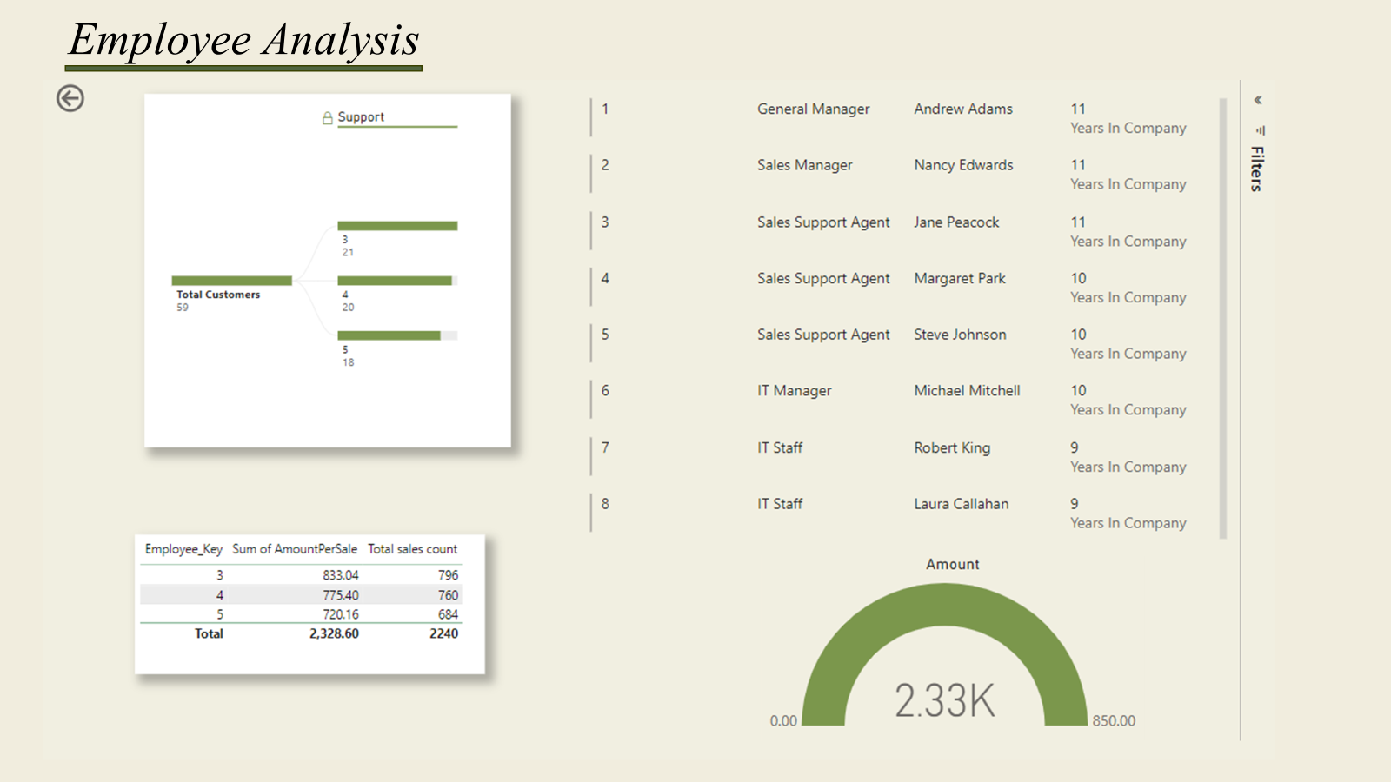

Slide 14
AREAS OF FOCUS
Peak Sales Achieved: Notable sales peaks were observed in the years 2010 and 2012, marking them as the most successful periods.
Geographic Sales Leader: North America emerged as the top-performing region, contributing the highest number of sales.
Dominant Media Type: Audio files dominated the sales portfolio, accounting for approximately 90% of total sales.
Top Product Sales by Band: Iron Maiden leads in product sales, with their member Steve Harris ranking in the top 10 list of best-selling composers.
U2's Significant Market Share: U2 also holds a significant percentage of sales in multiple categories, including boot merchandise.
Leading TV Show: 'Lost' stands out as the most successful in terms of sales, far outpacing other TV shows.
Genre Dominance: The Rock genre achieves more than double the sales of the second most popular genre, showcasing its remarkable success.
Preferred Track Duration: Tracks lasting between 3 to 6 minutes are most popular, aligning with the common duration range of most tracks.
Employee Performance: While employees generally served a similar number of customers, a noticeable difference in sales is observed between Employee 3 and Employee 5, with the latter showing lower turnover

Slide 15

SUGGESTIONS
Strengthen Relationships With Top Performers
Capitalize On Popular Tv Shows
Focus On Rock Genre
Reskill, Upskill And Motivate Employees
Tailor Marketing Strategies To Top-performing Regions

Slide 16

Questions

Slide 17

Thank you
for you attention!

